Slide 1
BASIC NETWORKING
PRESENTED BY-:
SNOC RAIPUR

Slide 2
What are the basics of networking devices?
The essentials of any networking system are routers, wireless access points, and switches. These devices help a network establish communication within the network or outside the network.
Why do we need networking devices?
Networking devices have the following uses and benefits:
1. Help users to share files
2. Helps in hardware sharing such as a printer, hard drive, scanner, etc.
3. Allows application sharing
4. Let users communicate via email, video chat, etc.
5. Supports multi-player gaming
6. Allows sending calls via Voice over IP (VoIP)

Slide 3
Types of Network Devices The most common types of network devices are
Repeater
Network Hub
Bridge
Switch
Modem
Gateway/Router
Access Point

Slide 4
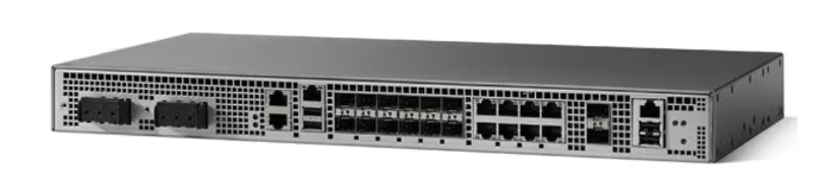
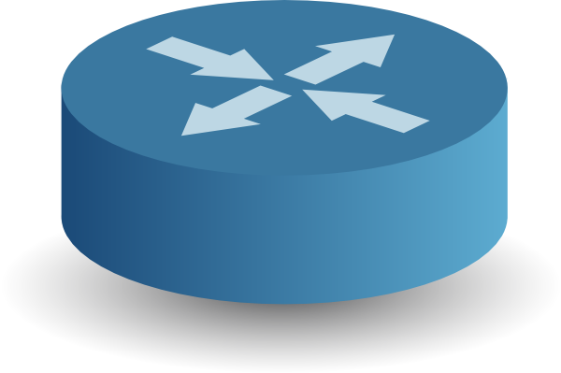
ROUTER
It is a route device which defines router of data
It reads the packet and filter them
It works on IP address network
It manages all traffic inside the routing
Here an example of CISCO ASR 920 router

Slide 5
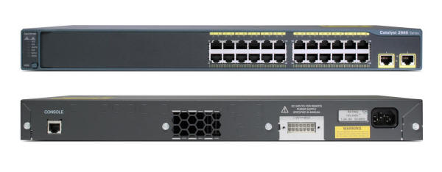

SWITCH
Switch is a computer networking device that connects devices together on a computer network, by using packet switching to receive, process and forward data to the destination device.
Here an example of CISCO SWITCH 2960-24T switch

Slide 6
IP ADDRESSING and SUBNETTING IP ADDRESSING
Internet Protocol address (IP address) is a numerical label assigned to each device (e.g., computer, printer) participating in a computer network that uses the Internet Protocol for communication.
Types of IP address
IPv4 – Internet Protocol version 4
IPv6 – Internet Protocol version 6

Slide 7
SUBNETTING
It is process of dividation of IPs into subparts.
We require subnetting in order to reduce the cost
Example: Suppose we want to buy 100 IPs and each having cost of 260
=> Total Cost = 260 *100=> 26000
But through subnetting we need only single IP which is divided through subnetting into different IPs as below:
Example: 192.168.1.0 Main IP
192.168.1.1
192.168.1.2
192.168.1.3 and so on……………

Slide 8
CONCEPT OF CLASSES
There are five types of classes namely A,B,C,D,E described below.
But in Practical Networking we prefer CLASS C only.
S.NO | CLASS | NETWORK BIT | HOST BIT | RANGE | SUBNET | WILDMASK
1 | A | 8 | 24 | 1-126 | 255.0.0.0 | 0.255.2555.255
2 | B | 16 | 16 | 128-191 | 255.255.0.0 | 0.0.255.255
3 | C | 24 | 8 | 192-223 | 255.255.255.0 | 0.0.0.255
4 | D | BROADCAST |  | 224-239
5 | E | RESEARCH |  | 240-255

Slide 9
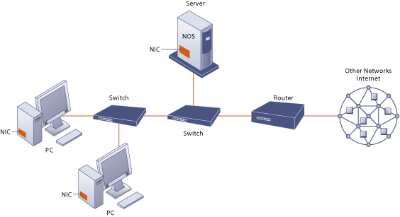
Components of a Simple Network
Figure 8-4

Slide 10
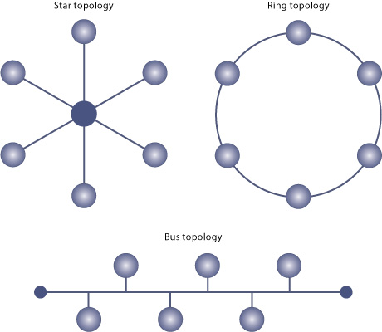
Network Topologies

Slide 11
OSI Reference Model
OSI Reference Model - internationally standardised network architecture.
OSI = Open Systems Interconnection: deals with open systems, i.e. systems open for communications with other systems.
Specified in ISO 7498.
Model has 7 layers.

Slide 12
7-Layer OSI Model
Layer 7
Application Layer
Layers 1-4 relate to communications technology.
Layers 5-7 relate to user applications.
Layer 6
Presentation Layer
Layer 5
Session Layer
Layer 4
Transport Layer
Layer 3
Network Layer
Layer 2
Data Link Layer
Layer 1
Physical Layer
Communications subnet boundary

Slide 13
Layer 7: Application Layer
Level at which applications access network services.
Represents services that directly support software applications for file transfers, database access, and electronic mail etc.
Layer 6: Presentation Layer
Related to representation of transmitted data
Translates different data representations from the Application layer into uniform standard format
Providing services for secure efficient data transmission
e.g. data encryption, and data compression.
Notes:
The Application Layer is home to a wide variety of protocols to meet specific user needs.
Network virtual terminal. Used by ‘networked screen editors’ and other networked applications needing to handle many different terminal types. Software exists to map the functions of the virtual terminal onto the real terminal, e.g. cursor movement. Examples include OSI VTP and Internet telnet.
File transfer. Different file systems have different file naming conventions and internal record structures. Such a protocol must convert files to a ‘standard’ representation. Examples include OSI FTAM and Internet ftp.
Electronic mail. Examples of electronic mail protocols are OSI X.400 and Internet mail.
Directory service. Examples include OSI X.500.

Slide 14
Layer 5: Session Layer
Allows two applications on different computers to establish, use, and end a session.
e.g. file transfer, remote login
Establishes dialog control
Regulates which side transmits, plus when and how long it transmits.
Performs token management and synchronization.
Layer 4: Transport Layer
Manages transmission packets
Repackages long messages, when necessary, into small packets for transmission
Reassembles packets in correct order to get the original message.
Handles error recognition and recovery.
Transport layer at receiving acknowledges packet delivery.
Notes:
The Session Layer allows the establishment of sessions between machines, e.g. to allow remote logins to a multi-user system, or to perform file transfer between machines.
One of the Session services is dialogue control; if the communications are half-duplex then the session layer can manage which entity sends when.
A related service is token management. In some protocols it is essential that both entities do not attempt the same operation simultaneously. Possession of a token permits the operation.
The other main Session service is synchronization. As an example consider attempting a 2-hour file transfer between machines which crash on average once an hour. The synchronization service provides a means for checkpoints to be inserted into the data stream so that, after a crash, only data sent since the last checkpoint needs to be re-transmitted.

Slide 15
Layer 3: Network Layer
Manages addressing/routing of data within the subnet
Addresses messages and translates logical addresses and names into physical addresses.
Determines the route from the source to the destination computer
Manages traffic problems, such as switching, routing, and controlling the congestion of data packets.
Routing can be:
Based on static tables
determined at start of each session
Individually determined for each packet, reflecting the current network load.
Notes:
The Network Layer controls the subnet.
The key design issue is routing of data within the subnet. Routing can be:
based on static tables (rarely changed),
determined at the start of each session, or
highly dynamic: individually determined for each packet, reflecting the current network load.
Too many packets in the subnet simultaneously can form bottlenecks; this is dealt with by congestion control procedures in the Network Layer.
Accounting for subnet use is also typically the responsibility of the Network Layer.
When a packet travels from one network to another, address conversion may be necessary; this is also performed by the Network Layer.
In Broadcast networks (e.g. many LANs), the routing problem is very straightforward, and hence Layer 3 will be very simple, or even non-existent.

Slide 16
Layer 2: Data Link Layer
Packages raw bits from the Physical layer into frames (logical, structured packets for data).
Provides reliable transmission of frames
It waits for an acknowledgment from the receiving computer.
Retransmits frames for which acknowledgement not received
Layer 1: Physical Layer
Transmits bits from one computer to another
Regulates the transmission of a stream of bits over a physical medium.
Defines how the cable is attached to the network adapter and what transmission technique is used to send data over the cable.
Notes:
This layer takes the ‘raw’ transmission facility provided by the Physical Layer (Layer 1) and uses it to provide a reliable, error-free transmission service.
It does this by breaking the data stream up into frames, typically of thousands of bytes in length. Where necessary, special acknowledgement frames can be sent back by the receiving Data Link entity to indicate successful receipt of each frame.
The Physical Layer transmits a continuous sequence of bits, and so Layer 2 must create and recognise frame boundaries. This is typically done by the insertion of special bit patterns.
Channel errors can completely destroy a frame, and hence retransmission may be necessary. This, in turn, leads to the possibility of duplicate frames being received. Data Link protocols must deal with these problems.
A Data Link protocol may offer several different ‘service classes’ to the Network Layer, each with a different quality and cost.
The Data Link Layer must also regulate traffic flow to prevent ‘swamping’ of a slow receiver.
In a duplex channel there may be competition between data and acknowledgment frames; one solution is known as piggybacking, where acknowledgement information is attached to data frames.

Slide 17
Virtual Local Area Networks (VLANs)
A VLAN allows you to take one physical switch, and break it up into smaller mini-switches.
Below is a network with three different physical switches. The switches facilitate communication within networks, and the Routers facilitate communication between networks.

Slide 18
Breaking up one Physical Switch into multiple Virtual Switches
Breaking up one Physical Switch into multiple Virtual Switches
Traffic flow through the single switch of this topology operates exactly as it did in the topology above it with three separate physical switches. The routers are configured and operate exactly as they did above.
Traffic arriving on a switch port assigned to one VLAN will only ever be forwarded out another switch port that belongs to the same VLAN – a switch will never allow traffic to cross a VLAN boundary. Again, each VLAN operates as if it were a completely separate physical switch.

Slide 19
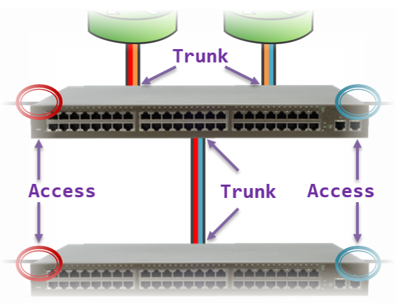
An Access port is a switch port that is a member of only one VLAN.
A Trunk port is a switch port that carries traffic for multiple VLANs

Slide 20
Typically, switch ports connected to end-host devices are configured as Access ports (e.g., workstations, printers, servers). Switch ports connected to other network devices are configured as Trunk ports (e.g., other switches, routers)
whenever a Switch is sending frames out a Trunk port, it adds to each frame a tag to indicate to the other end what VLAN that frame belongs to. This allows the receiving switch to read the VLAN tag in order to determine what VLAN the incoming traffic should be associated to.
An Access port, by comparison, can only ever carry or receive traffic for a single VLAN. Therefore, there is no need to add a VLAN Tag to traffic leaving an Access port.
Trunk or Tagged port (i.e., a switch port that carries traffic for more than one VLAN)
Access or Untagged port (i.e., a switch port that carries traffic for only one VLAN)

Slide 21
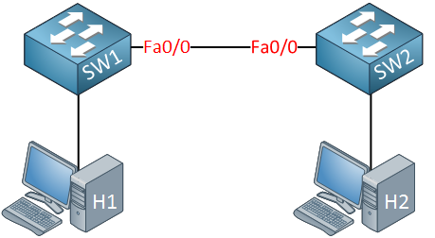
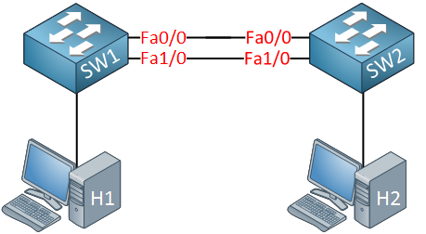
STP- STP (Spanning-Tree)
STP (Spanning-Tree) is a layer two protocol that creates a loop-free topology on a switched network. It does so by selecting a root bridge, then selecting root ports on all other switches that are non-root bridges. All other segments will have a designated and non-designated interface, where the non-designated interface will be blocked, creating a tree-like loop-free topology.
Why do we need spanning-tree?
we have two switches. These switches are connected with a single cable, so there is a single point of failure. To get rid of this single point of failure, we will add another cable:
With the extra cable, we now have redundancy. Unfortunately for us, redundancy also brings loops.

Slide 22
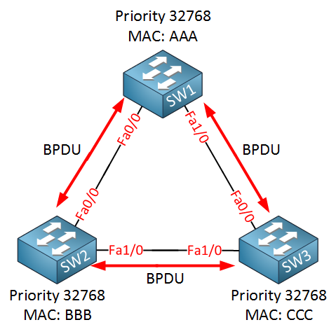
Ok, now we have added redundancy by connecting the switches in an additional switch, this also means we have a loop here.
How to solve this loops?
How spanning-tree solves loops?
Spanning-tree will help us to create a loop-free by blocking certain interfaces.
Spanning-tree requires the bridge ID for its calculation.
Priority and MAC address make up the bridge ID.

Slide 23
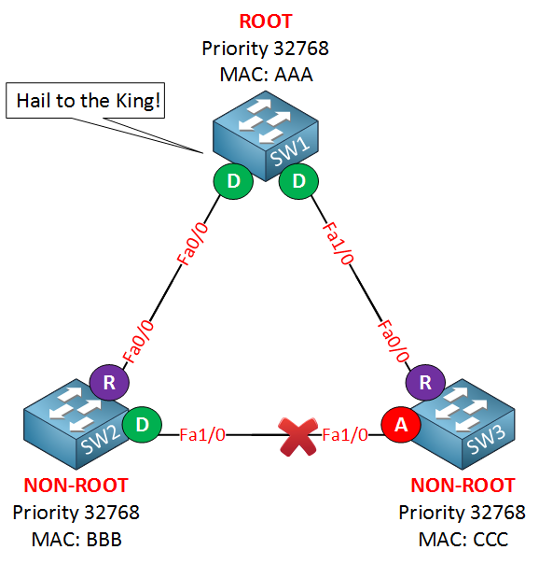
Spanning-tree will elect a root bridge; this root bridge will be the one that has the best “bridge ID”.
The switch with the lowest bridge ID is the best one.
Bridge ID = Priority + MAC address.
who will become the root bridge?
SW1 will become the root bridge!
Since the priority is the same on all switches, it will be the MAC address that is the tiebreaker. SW1 has the lowest MAC address thus the best bridge ID and will become the root bridge.
The ports on root bridge are always designated, which means they are in a forwarding state.
The shortest path to the root bridge is called the “root port” on SW2 and SW3.
We still have a loop, so we need to shut down a port between SW2 and SW3 to break that loop.
SW3 is has smaller BI, which means it will have to block its port.

Slide 24
EtherChannel
EtherChannel is a port link aggregation technology to combine multiple physical links between two network switches into a single logical link.
This logical link provides increased bandwidth and redundancy, as well as improved load balancing. A maximum of 8 links can be aggregated to form a single logical link.
Criteria – To form an EtherChannel, all ports should have:
Same duplex
Same speed
Same VLAN configuration (i.e., native VLAN and allowed VLAN should be same)
Switch port modes should be the same (access or trunk mode)
EtherChannel protocols – To form an EtherChannel, there are 2 protocols, port aggregation Protocol (PAgP) and link aggregation control protocol (LACP).
1. Port Aggregation Protocol (PAgP) – The Cisco proprietary that involves the logical aggregation of Cisco Ethernet switch ports.
2. Link Aggregation Control Protocol (LACP) – Link Aggregation Control Protocol is an IEEE protocol, originally defined in 802.3ad.

Slide 25
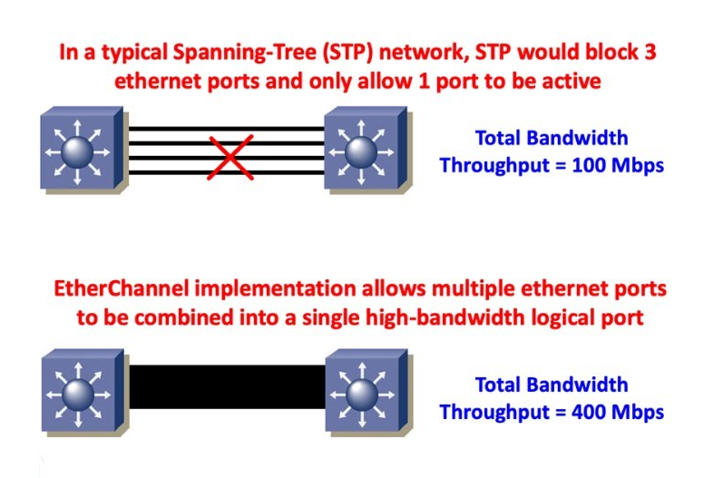
Advantages, including:
EtherChannel provides increased bandwidth between switches. This can help improve network performance and reduce bottlenecks.
EtherChannel provides improved redundancy by allowing traffic to be routed over multiple physical links.
EtherChannel distributes traffic across multiple physical links, providing improved load balancing and preventing congestion on any one link.
EtherChannel simplifies network configuration by treating multiple physical links as a single logical link. This can reduce the complexity of network configurations and make troubleshooting easier.
EtherChannel can be a cost-effective way, as it allows existing physical links to be used rather than requiring new hardware.

Slide 26
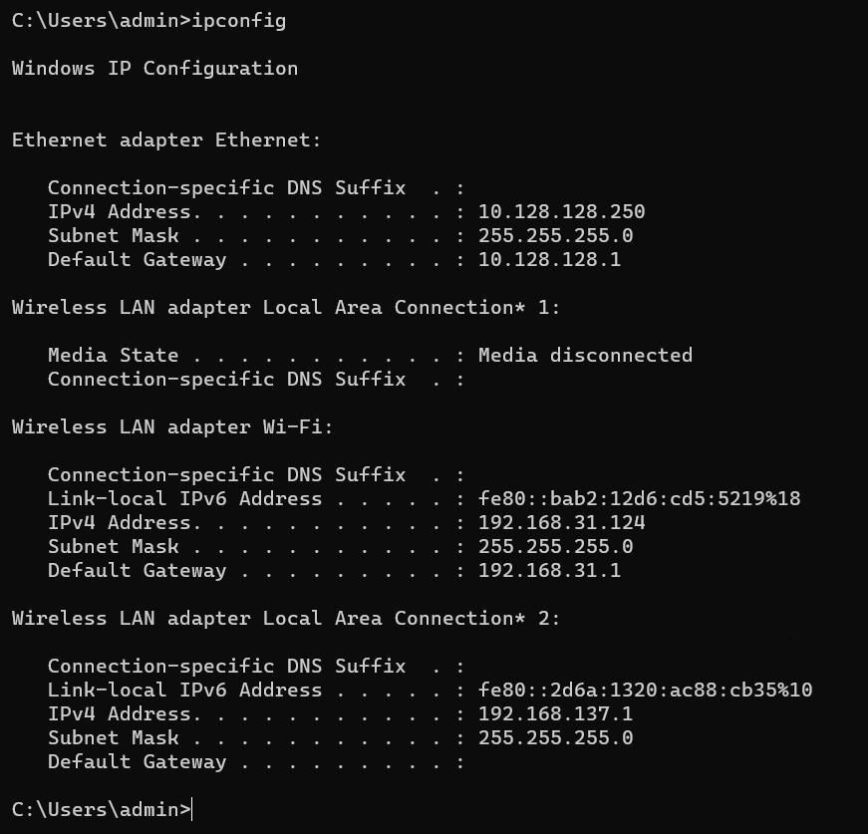
Ipconfig command
This is one of the most useful IP commands on Windows. It displays tons of useful information about the current network settings on the machine such as IPv4 and IPv6 address of all network interface cards (Ethernet adapters, WiFi adapters, virtual network adapters etc), MAC address, default gateway, subnet mask, DNS server, DHCP information etc.
Ipconfig
In order to see more details such as the MAC address of the system, enter the command
ipconfig/all
Commands are used in DHCP mode only
ipconfig /release
ipconfig /renew

Slide 27
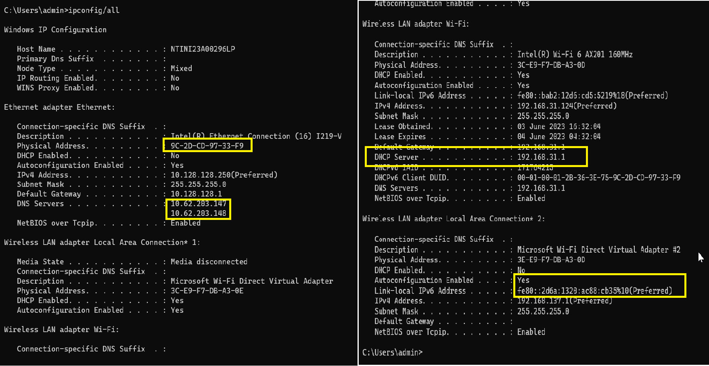

Slide 28
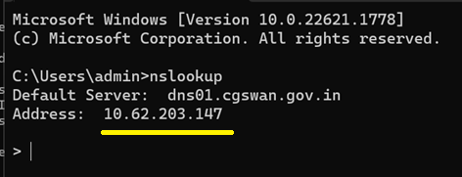
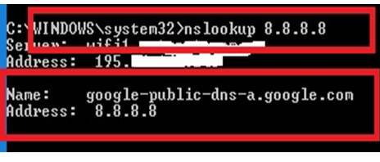
Nslookup command
“nslookup” stands for “Name System Lookup” and is very useful in obtaining Domain Name System (DNS) related information about a domain or about an IP address (reverse DNS lookup).
nslookup [IP Address]: This will perform a reverse-DNS lookup and will try to match the given IP address in the command with its corresponding domain name.
Nslookup
Will provide the present DNS server which is in use.
nslookup 8.8.8.8

Slide 29
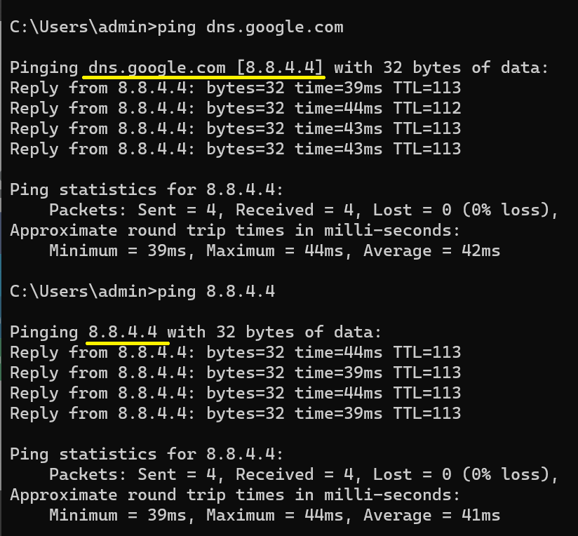
Ping command
This will quickly show you if can send and receive packets (icmp packets to be exact) from your computer and hence shows whether you have network connectivity or not.
Note also that “ping” is useful for testing connectivity for both the local computer from where you execute the command and also for a remote computer or server which you try to reach.
When “pinging” a hostname or domain name, the command will resolve first the name to IP address and then send the icmp packets to that IP.

Slide 30
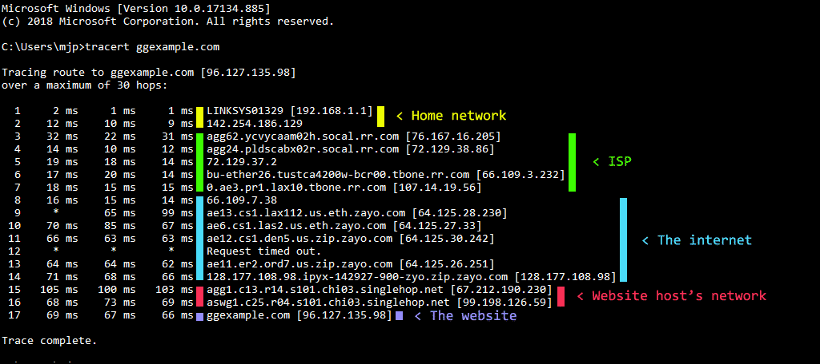
Tracert command
“tracert” in Windows traces the path that a TCP/IP packet takes towards a destination target and shows some information (if available) of the routing nodes within this path.
Advantages of tracert
It can determine the cause of a response delay in a network.
It determines the routing loops present in a network pathway across nodes that send and receive packets.
It finds the location of failed points in the network while packets move from source to destination.
Hop Number - This is the first column and is simply the number of the hop along the route. ...
RTT Columns - The next three columns display the round-trip time (RTT) for your packet to reach that point and return to your computer. ...
Domain/IP column - The last column has the IP address of the router.

